Slide 1
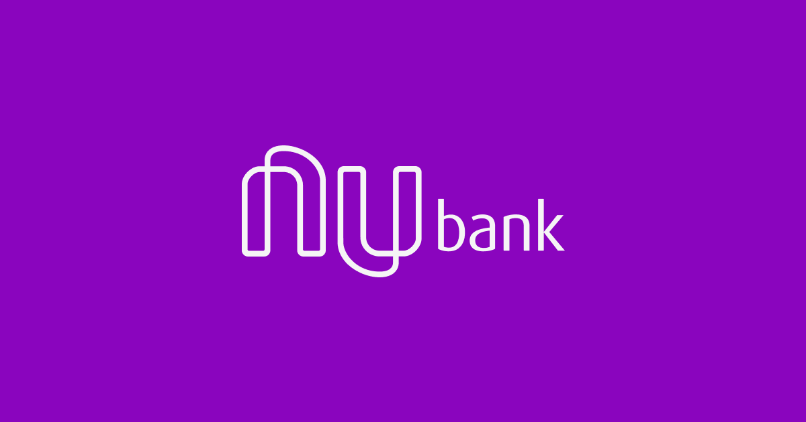
The Future is Purple
Gabriela Quesada, Julia Santos Nothaft, Soumya Suman, Theo Warren, Lucas Mears

Slide 2

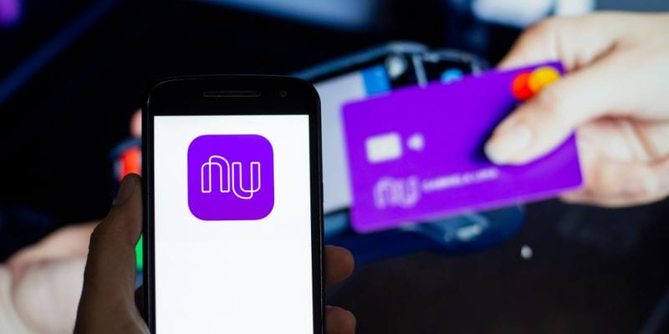
Executive Summary
NuBank is a new fintech company, started in 2013 that is solving all of banks traditional problems by digitizing the banking world
They have dominated Latin America by by creating a cheap, digital platform that has reduced rates, accessible to anyone with a phone.
We believe they have an opportunity to continue targeting this market, people without access to traditional banks.
Notes:
Executive Summary:
Start with what is nubank and the industry they operate in
How they have created value for consumers in this space, specifically Brazil their home region.
And our recommendations for how the can continue to target the unbanked community in need of financial services to increase personal wealth development overall.
Company:
NUbank is a finch company that started in Brazil, that really takes the most necessary functions of a traditional bank like credit cards, loans, savings account and financial advice, and completely digitalizes it.
They don't have any physical locations. So those types of costs are where they really save money.
Valued at 10 billion dollars, with 420 million dollars in annual revenue and were named most innovative company by fast company last year.
Their current losses are due to expansion costs, and ultimately they are still young and considered a start up
Industry:
Mixed bag in terms of profitability according to the forces. There are certain pressure points that could however be turned into opportunities.
Industry Trends and dynamics:
Increase global phone use- more options for finch solutions but also more opportunities for customer acquisition, Low switching costs for consumers because of wider internet access
Network effects necessary to create profitability, able to do that in Brazil their rates are less than half of brazils average for traditional banks. Able to achieve scale.
There are currently only regionally dominating products, room for a big player to take hold. interesting opportunities for someone like nubank

Slide 3
Industry Analysis

Slide 4
What is NuBank?
Digital Services and Offerings
NuBank in Numbers
Credit card and management systems
ATM withdrawals and direct deposits
Financial advising
Small business accounting
Small loans (both personal and small business)
All bank services minus hidden fees
Extensive rewards programs
10 Billion dollar evaluation
$420 Million in annual revenue (USD)
1.1Billion in initial funding (USD)
≅ 15Million users as of October 2019
Named #1 most innovative company in 2019 by FastCompany
Currently operating at a loss
Notes:
Executive Summary:
Start with what is nubank and the industry they operate in
How they have created value for consumers in this space, specifically Brazil their home region.
And our recommendations for how the can continue to target the unbanked community in need of financial services to increase personal wealth development overall.
Company:
NUbank is a finch company that started in Brazil, that really takes the most necessary functions of a traditional bank like credit cards, loans, savings account and financial advice, and completely digitalizes it.
They don't have any physical locations. So those types of costs are where they really save money.
Valued at 10 billion dollars, with 420 million dollars in annual revenue and were named most innovative company by fast company last year.
Their current losses are due to expansion costs, and ultimately they are still young and considered a start up
Industry:
Mixed bag in terms of profitability according to the forces. There are certain pressure points that could however be turned into opportunities.
Industry Trends and dynamics:
Increase global phone use- more options for finch solutions but also more opportunities for customer acquisition, Low switching costs for consumers because of wider internet access
Network effects necessary to create profitability, able to do that in Brazil their rates are less than half of brazils average for traditional banks. Able to achieve scale.
There are currently only regionally dominating products, room for a big player to take hold. interesting opportunities for someone like nubank

Slide 5
Industry at a Glance
Threat of New Entrants: Low
Significant increased access to mobile phones in developing countries
High barriers of entry
Buyer Power: Low to Moderate
Low switching costs
Only regional fintech options
Threat of New Entrants
Buyer Power
Rivalry: Moderate
Several competitors globally
Dominant regional players
Regional players tend to focus on a specific product
Rivalry
Supplier Power: High
Funding is crucial
Most fintech are startups
Finding the right venture capitalist is difficult
Supplier Power
Threat of Substitutes
Threat of Substitutes: High
Specific service orientation of fintech companies
Different companies focus on different regions
10,000+ fintech companies
Notes:
Executive Summary:
Start with what is nubank and the industry they operate in
How they have created value for consumers in this space, specifically Brazil their home region.
And our recommendations for how the can continue to target the unbanked community in need of financial services to increase personal wealth development overall.
Company:
NUbank is a fintech company that started in Brazil, that really takes the most necessary functions of a traditional bank like credit cards, loans, savings account and financial advice, and completely digitalizes it.
They don't have any physical locations. So those types of costs are where they really save money.
Valued at 10 billion dollars, with 420 million dollars in annual revenue and were named most innovative company by fast company last year.
Their current losses are due to expansion costs, and ultimately they are still young and considered a start up
Industry:
Mixed bag in terms of profitability according to the forces. There are certain pressure points that could however be turned into opportunities.
Industry Trends and dynamics:
Increase global phone use- more options for finch solutions but also more opportunities for customer acquisition, Low switching costs for consumers because of wider internet access
Network effects necessary to create profitability, able to do that in Brazil their rates are less than half of brazils average for traditional banks. Able to achieve scale.
There are currently only regionally dominating products, room for a big player to take hold. interesting opportunities for someone like nubank

Slide 6
Value Creation

Slide 7
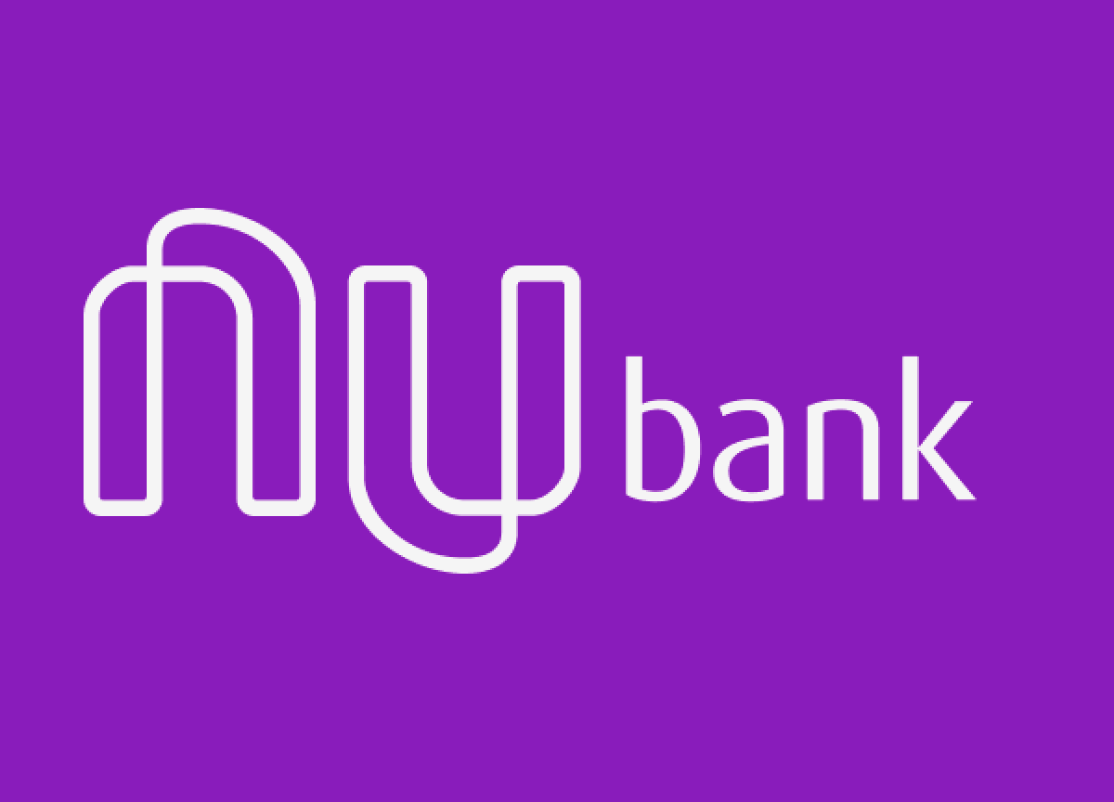
Firm Level Analysis
Valuable
Rare
Imitable
Organized
Better Technology and brand creates differentiation and value from competitors
Other companies do not have technology or reputation to operate entirely digitally
Investments cost associated with brick and mortar banking has locked the competition up
Nubank is using their technology and brand to expand into new markets
Cost Leader Differentiation
First Mover Advantages:
Geographic dominance, Build brand before competition starts
Creating Advantage
Narrow Broad
Generic Advantages:
Cost leader, narrow market, expansion opportunities
Notes:
A large part of NuBank’s success, is a result of their early penetration into the market. Now they continue to exceed substitutes and other new entrants with their superior technology. Their tech has made them easily accessible and easy to use all while being the cost leader; creating tremendous value for their users. Other competitors have tried to enter the field, yet NuBank continues to supersede them because of how difficult they are to imitate.
Their advancements in AI continues to make their services better than ever. Now after gaining dominance in their home country of Brazil, they have the opportunity to continue expansion into the other densely populated, low banked countries.

Slide 8
The Platform + Data Science
Platform
A platform based off user feedback about existing banks, to maintain services without pitfalls
NuConta- Nubank’s digital accounts
NuBank simple credit card program
Digital account services
Personal loan services
NuBank rewards
NuConta – small & medium business accounts
Utilizing Data Science
Data science is the key to their business to make the user experience as simple as possible, AI is used to
analyze credit card apps, categorizes users
Green - receive credit within a week
Yellow - might receive credit within 90 days
Red - not eligible to receive credit
adjusts credit limit based on monthly expenses and credit score, categorize users
Proactive - automatic limit increases over time
Reactive - increases limit upon request
prevents credit determination and prevents the company from losing money
Notes:
NuBanks value was initially found by listening to Brazils banks lead users, they have been able to find the problems with the banking world and eliminate them. Digitizing the banking experience has allowed them to create an extensive platform matching brick and mortar banks, while avoiding traditional pitfalls and replace them with: low rates on accounts and credit cards, reduced loan rates payments on the users time, and rewards for things people actually want with no hidden fees when users try to use them.
NuBank has been using AI and data science to organize and categorize users for eligibility of loans, credit cards, and credit extensions. Using AI to do this is not only good for users credit scores, but saves NuBank money allowing them to serve more people who can’t afford traditional banking while still remaining profitable.

Slide 9
Value Proposition and Creation
 | Traditional Banks | NuBank Offerings | Benefits | Long Tail Benefits
Offerings | credit card ATM withdrawals checking deposits financial advising | Digital credit card ATM withdrawals digital check depositing digital money holding Loans Rewards Programs | Requires less employees Reduced costs Better margin on smaller rates | Able to access more users Able to reach remote users Better returns Increased AUM
Value | Physical locations Customer service | Extensive rewards programs Instant accessibility | No brick and mortar costs Accessible anywhere | Added benefits of using NuBank Raises cost of leaving Long term users
Pests | High rates Hidden fees Need to go into bank to use services | No option for in person banking People must have a phone | Phone accessibility is increasing AI to decrease need for in person visits | Increased user base transfer to small business users
Notes:
Here you can see an outline of how NuBank compares to traditional banks. In terms of services and offerings, they are largely the same. However, by being digital they expand who they can access, all while reducing rates from as high as 400% interest to less than 10% for the same services. For traditional banks, their only advantage is over having physical spaces in which users can go to in for customer service or in person advising. This has also proven to be a drawback, preventing expansion and reaching more people.
Long term NuBank’s ability to reach anyone with a smartphone will be incredibly valuable. Their rewards programs attempt to turn casual users into long term bankers then potentially use NuBank for small business loans as well. Minimizing drawbacks will really allow them to expand, and for that we have our recommendations

Slide 10
Recommendations

Slide 11
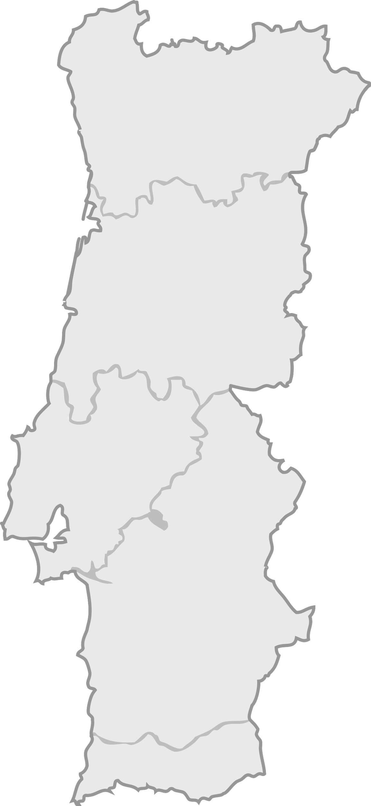
Geographic Expansion
Mexico
Largest population of unbanked in the West
Easy geographic move
Portugal
Potentially Portugal as first European entry
South America
Continue building relations in south America
Expansion from Brazil to other countries
(Chile, Argentina, etc.)
Notes:
FINAL WORDS: and will have people from neighbor countries using its services
Taking into consideration the whole analysis made, the team believes that the best next step for Nubank is to expand to additional countries in Latin America. More specifically, we believe that the company should continue its expansion in Mexico and once it establishes itself in this country, move on to the Carribean. This recommendation is mainly due to the fact that Latin American countries have a younger population with an average age of 31 years old who are traditionally an age group that is technologically savvy. The expansion into the United States should happen after the expansion to Mexico as this expansion could be facilitated by the fact that Nubank could offer services that make it easier for these communities to transfer money to their families in Latin America if they all were Nubank clients. Once established in these regions, the company should then focus on expanding to Portugal, due to language similarities and the fact that many Brazilians choose to immigrate to this country, Once established in Portugal, Nubank can then start to expand to Spain, since at this point the company will have a fully operational system in spanish (Due to the previous expansion to Mexico) and will have people from neighbor countries using its services.

Slide 12
Improving Services
Globalization
Simplicity
Customer Service
Available in more languages
Surveys with current users
Continue pursuing lead users, exploit flaws in banking
Increase accessibility
Advertise the ease of use
Directed marketing of ease of use to older generation of unbanked
Create an online service that matches the service of physical banks
Expand call centers with more languages
Continue AI expansion
Notes:
FINAL WORDS: Nubank can continue their mission of serving different communities easily, conveniently, and digitally.
To help with its geographic expansion and attract even more clients we believe that Nubank have services available not only in portuguese, but also in English and Spanish. It should also continue to pursue lead users to improve their services.
We would also recommend Nubank continue to develop digital services similar to ones existent in physical banks. One way to address this is for Nubank to set up online customer service centers in the unique regions they expand into to provide quality customer service internationally. Nubank should also continue to develop their AI, and introduce a feature similar to Bank of America’s Erica that can interact with a user and answer any questions they have. Finally, Nubank should also focus on expanding their offerings in regards to financial advice and recommendations, either by introducing something similar to a blog on their app and website or by hiring specialists to take questions over a chat room or through phone call.
Overall, Nubank has had tremendous success thus far by providing value to unbanked populations of Brazil through a variety of services that mirror a traditional bank. Through these service improvements, as well as their international expansion, Nubank can continue their mission of serving different communities easily, conveniently, and digitally.

Slide 13
Thank You

